Slide 1
Making your first Tools Module
Mike Kanakos

Slide 2
Overview
PART 1: What is a module? (slides)
PART 2: Creating your first module (demos)
PART 3: Sharing your module (demos)

Slide 3
Get-Speakerinfo
Align Technology:
RTPSUG:
PowerShell.org:
Website:
Writer:
AD/Infrastructure Tools Engineer
Co-leader
Director Community Engagement
www.networkadm.in
4sysops.com & ipswitch.com

Slide 4
References & Thank You’s
PowerShellExplained: https://powershellexplained.com/2017-05-27-Powershell-module-building-basics
Microsoft Docs: https://docs.microsoft.com/en-us/powershell/
Thank you:
@steviecoaster - chocolatey

Slide 5
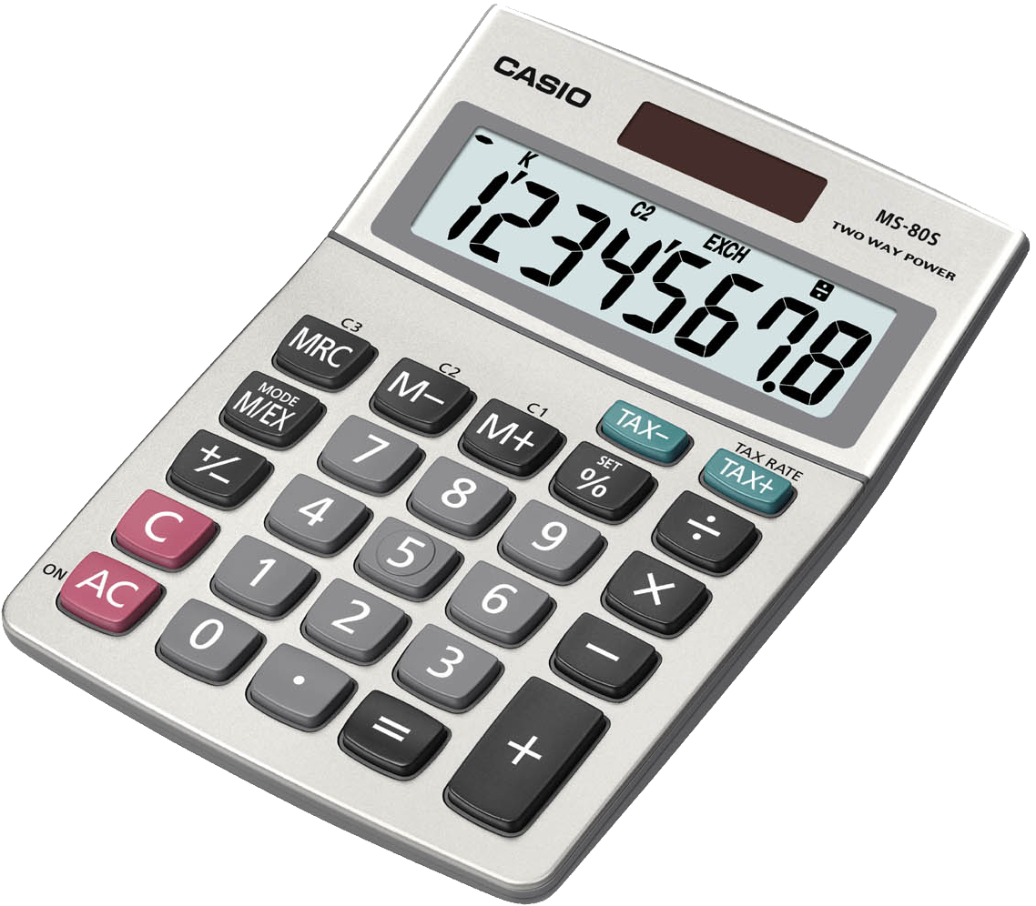
Let’s go back to school…
56 x 23 = 1288

Slide 6
What is a module?

Slide 7
What is a module?
A portable package that contains PowerShell commands
Cmdlets, Providers, Functions
Workflows, Variables, Aliases

Slide 8
Why make a module?
Portability
Share code with others (people & computers)

Slide 9
Major pieces of a module
Code (.ps1 files)
Supporting Files (helper scripts)
Manifest (metadata)
A directory

Slide 10
Major pieces of a module
.PSM1 (code)
.PSD1 (manifest /metadata)
Public/Private
Documentation
@MikeKanakos www.networkadm.in

Slide 11
Major pieces of a module
.PSM1 (code)
PSM1 is where the code lives
any valid PowerShell script can be saved as a .psm1
PSM1 file needs to be saved in a folder of the same name
Module folder needs to be in one of the paths in $env:PSModulePath

Slide 12
Major pieces of a module
.PSD1 (manifest/metadata)
PSD1 contains the info about the module
Describes the contents and attributes of the module
Module Name, Version, Author, GUID, etc
Defines any pre-req’s (ie required PS version and modules)
Not required

